Slide 1
CRAFT DEMONSTRATION
SHIVANG MISHRA

Slide 2
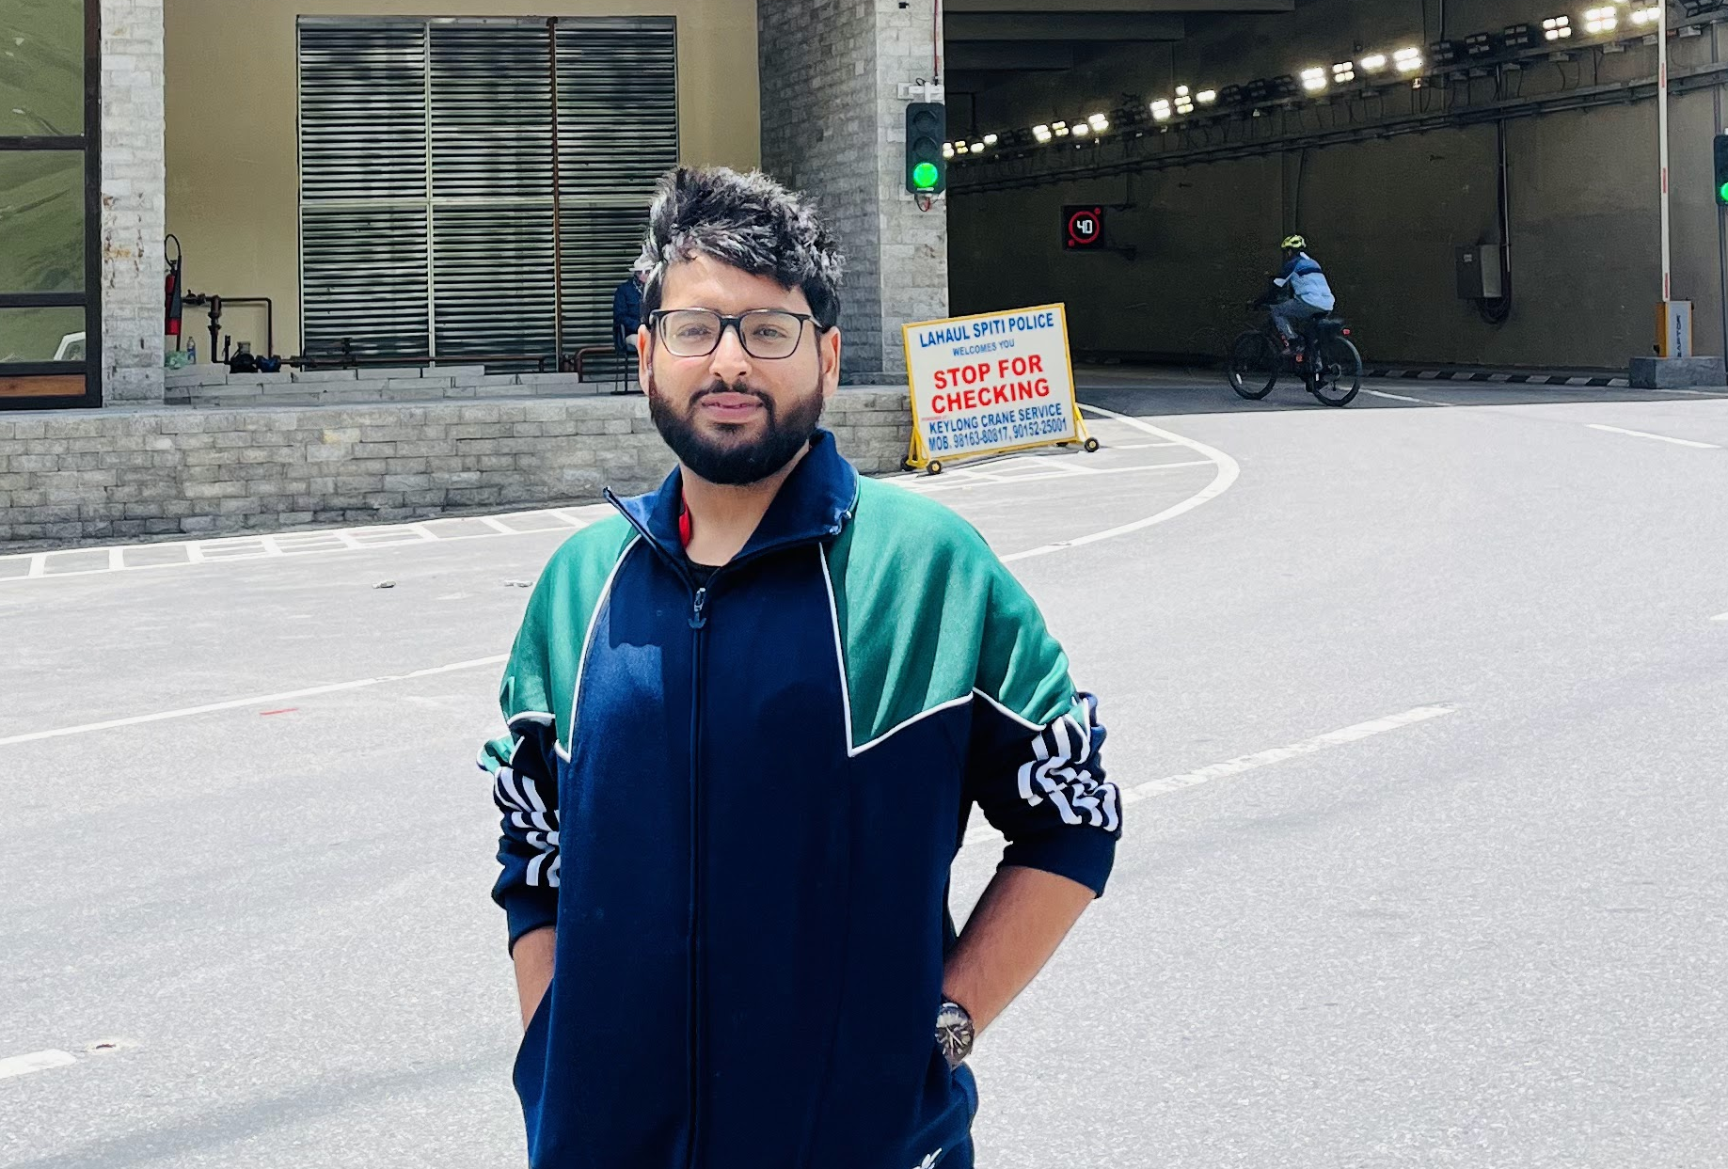
Who am I? Shivang Mishra
Seasoned .NET Developer with 3 years of experience focused on backend with a passion of building world class products and drive innovation.

Slide 3
Personal Info
Born and raised in Kanpur, U.P., where I did my basic education from CBSE board.
B.E. from UIET, Panjab University, Chandigarh (JEE Main) in Electronics & Communication Engineering. [2016-20]
Backend focused .NET developer with knowledge of other tools and languages like Java, C++, SQL, AWS.
Goals: Stay Fit, Work for animal welfare

Slide 4
Professional Info
Started my career as Software Engineering Intern at Gemini Solutions Pvt Ltd, Gurugram in Jan, 2020.
Converted to FTE in Aug, 2020. Got Promoted twice to become a Sr. Software Engineer L1.
Led team of junior developers in client projects and managed entire internal projects driving improvements in operational efficiency.
Domains : Fintech & Information Systems(IS)
Goals: Continuous Learning and Skill Enhancement.

Slide 5
PRODUCTS

Slide 6
PANORAMA
Built a platform for Portfolio Managers and Financial Advisors for data for their data analysis and visualization needs
Worked as a full stack developer creating front-end in WPF (MVVM using Prism) and backend in .NET Core Web API for 20+ modules in the application.
Implemented Autocomplete feature using Elasticsearch which significantly improved user experience by providing real-time suggestions.
Integrated caching mechanism resulting in reducing the latency by 80%.
Implemented several other features like data viz. through charts and maps, logging and pdf & excel creation with download.
Tech Stack: WPF, Prism, MVVM, ASP .NET Core Web API

Slide 7
ACHIEVEMENTS & OUTCOME
Successfully delivered the entire project on time despite losing two senior developers three to four months before the deadline and ensured all 50+ modules were completed.
Took charge and led a team of junior developers, significantly improving my leadership and project management skills.
Received high praise from the client for delivering the project without any delays.
Awarded “On The Spot" and recognized internally for exceptional performance and dedication

Slide 8
CASE STUDY FinNews Desktop App

Slide 9
Functional Requirements:
Develop the application using WPF for a desktop environment that allows users to enter a company's name and select a specific date.
Display financial metrics of the selected company for the specified date in a data grid.
Fetch and display the latest news related to the selected company.
Support for displaying images and videos within the news articles.
Retrieve the latest news from third-party sources related to the selected company.
Store a copy of the retrieved financial data
Implement logging of data retrieval and user interactions.
Send notifications to stakeholders in case of fatal errors or unhandled exceptions.

Slide 10
Non-Functional Requirements:
Scalability:Design the application to handle increased loads and user demands without performance degradation.
Consistency:Ensure data consistency, especially when fetching and displaying financial data and news from third-party sources.
Performance: Optimize the application for fast retrieval and display of financial data and news articles.
User Experience: Provide a user-friendly interface with intuitive and responsive design.

Slide 11
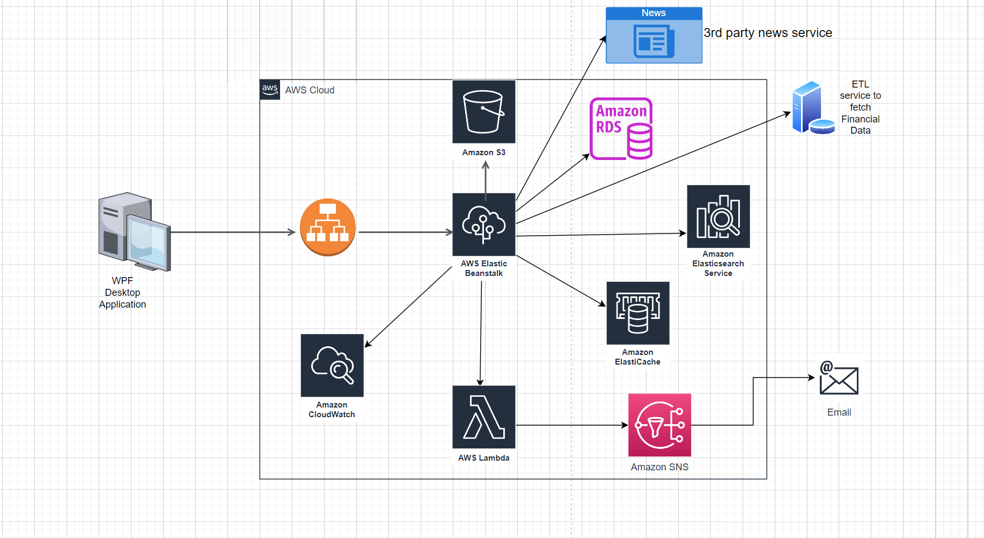
High Level Design

Slide 12
Scope of improvement:
Implement a cron job to fetch and update data for a list of companies every morning and pre-load data into the database and Elasticsearch to reduce initial data retrieval time and enhance user experience.
Use AWS SQS (Simple Queue Service) as a messaging queue between the Elastic Beanstalk application and AWS Lambda to ensure scalable and robust notification delivery
Implement user authentication and authorization using JWT and OAuth 2.0 to secure the application and manage user access effectively.
Add an autocomplete feature to enhance user experience.

Slide 13
Q/A

Slide 14
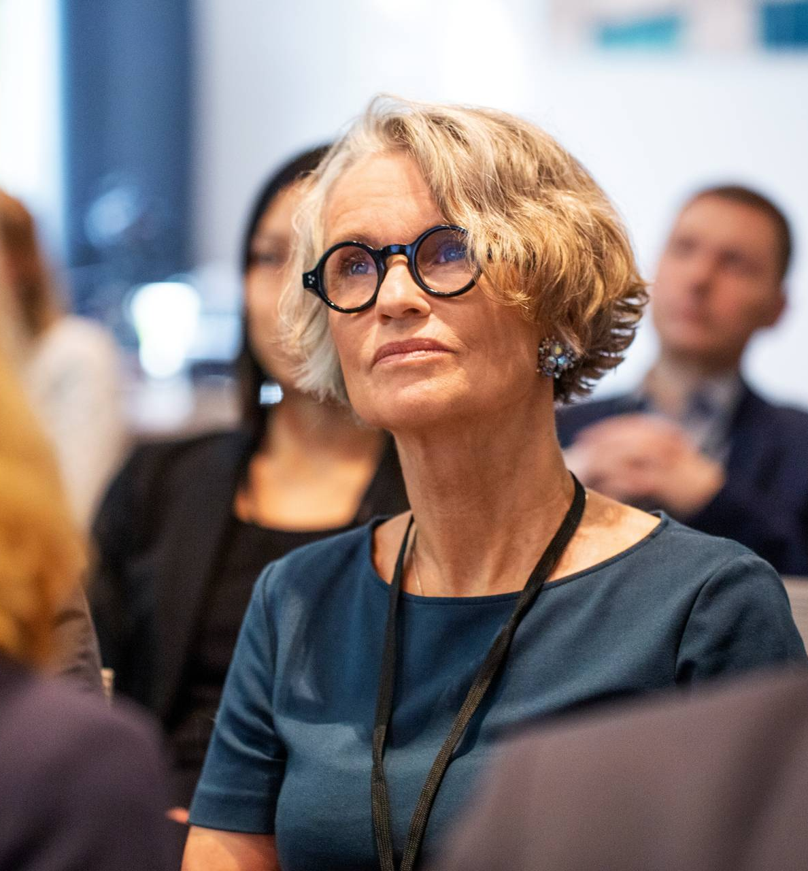
Why Intuit?
Innovative Culture and Impactful Work
Career Growth and Development
Work Environment and Benefits

Slide 15
ThankYou

